Slide 1
Learning Variables with Beyonce

Slide 2

Queen Bey’s Accomplishments are NUMEROUS
Today, we’re going to learn from them …

Slide 3
Music Awards (2019)
Grammy = 23
MTV = 28
Billboard = 23

Slide 4
Music Awards: Numbers
Grammy = 23
Name
Value
Will Beyonce win more grammys?
Duh! We’re talking about Queen Bey!
Grammy = 100
Name
Value
Notes:
Main teaching point: Variables can hold numbers and that we can easily change the numbers

Slide 5
Top Song: Strings
topSong = ‘Irreplaceable’
Name
Value
Top Song According To Who?
topSong = ‘Brown Skin Girl’
Name
Value
Notes:
Main teaching point: Variables can hold strings and that we can easily change the strings

Slide 6
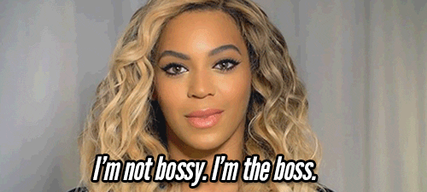
Who Run the World?
Boys = FALSE
Girls = TRUE
Name
Value
Name
Value
Notes:
Main teaching point: Variables can hold booleans

Slide 7


Let’s Start Coding
Dress Rehearsal with Royalty
Notes:
Only black women to hit #1 on the Hot 100, this decade!!! https://twitter.com/mediacharts/status/1168890800551411716

Slide 8
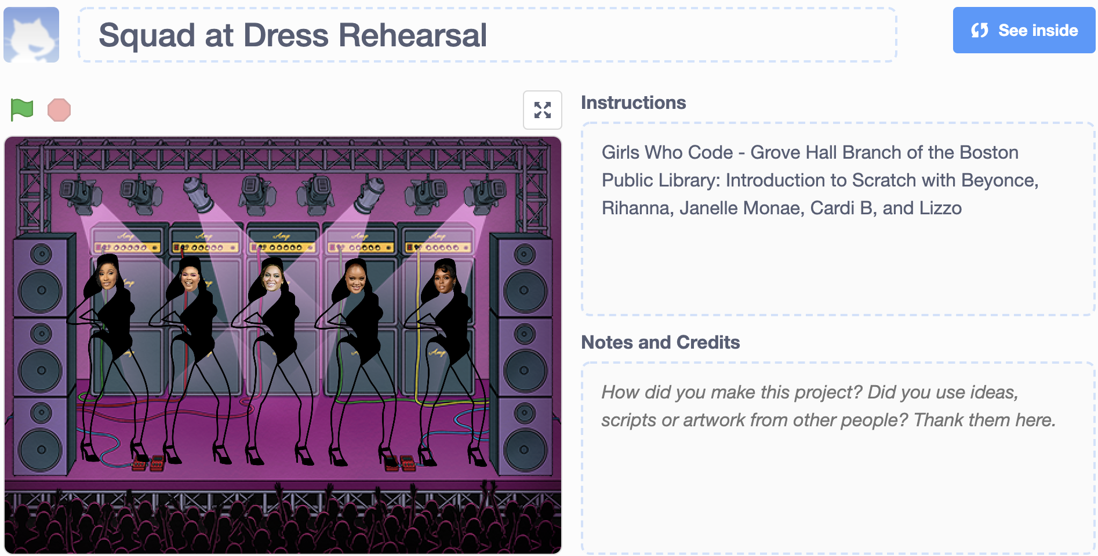
Getting Comfortable with Scratch

Slide 9

Log into Scratch and Hit ‘Remix’
https://scratch.mit.edu/projects/323709156/

Slide 10
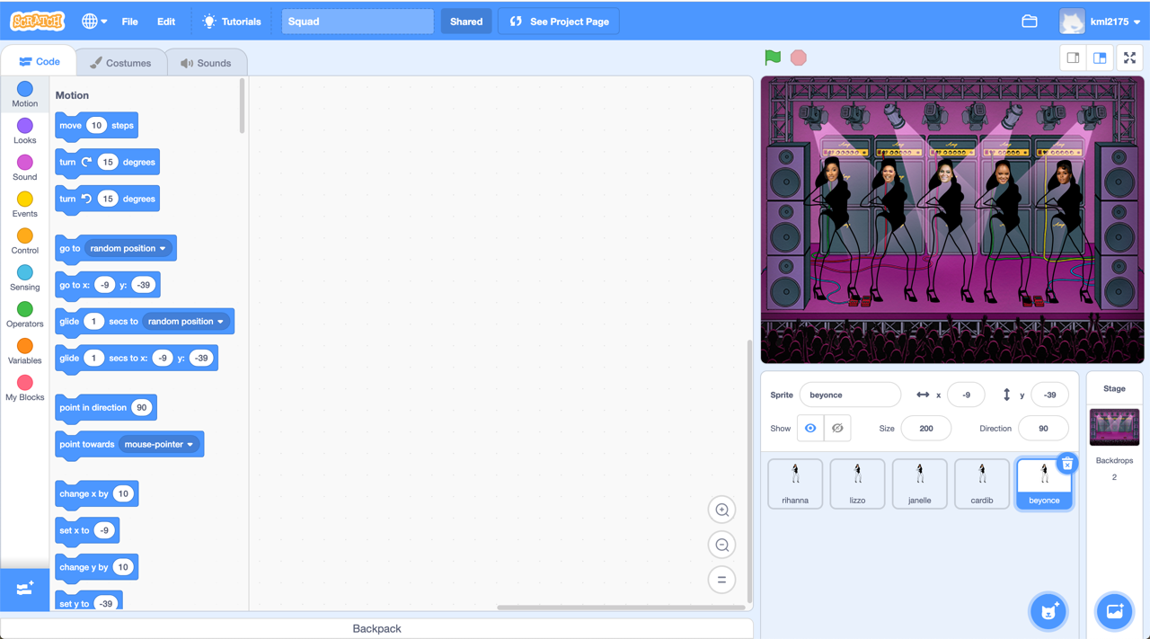
Code Blocks
Go here
Code Blocks
Character
& Background

Slide 11
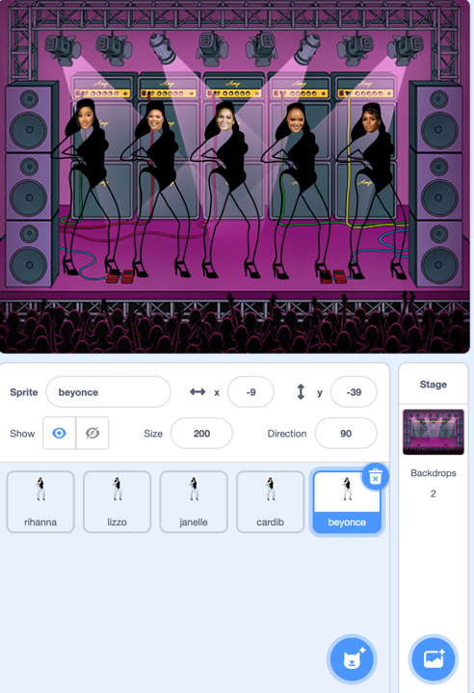
Background
Change Background with the Background Icon
Choose a different background

Slide 12
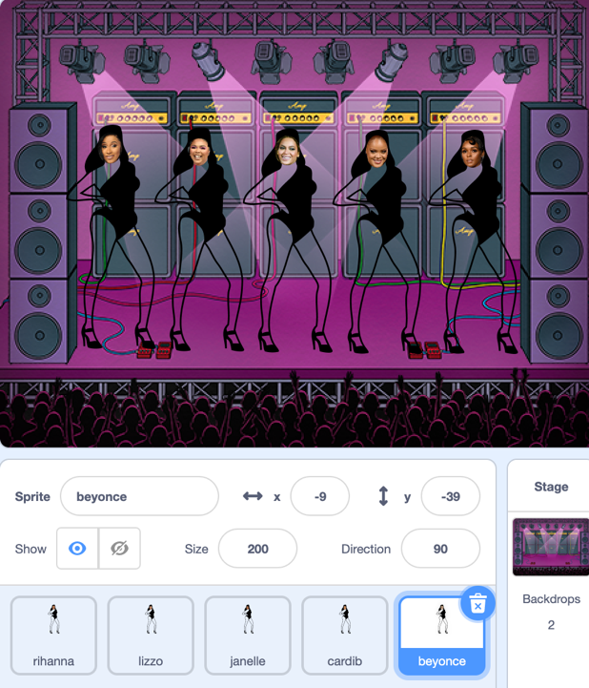
Characters
Select ‘Beyonce’ and Play with Character Options
Sprite: Name of Character
X = Changes the horizontal position of Beyonce
Y = Changes the vertical position of Beyonce
Show = Show or Hide Beyonce
Size = Changes Beyonce’s size
Direction: Changes Beyonce’s Direction

Slide 13
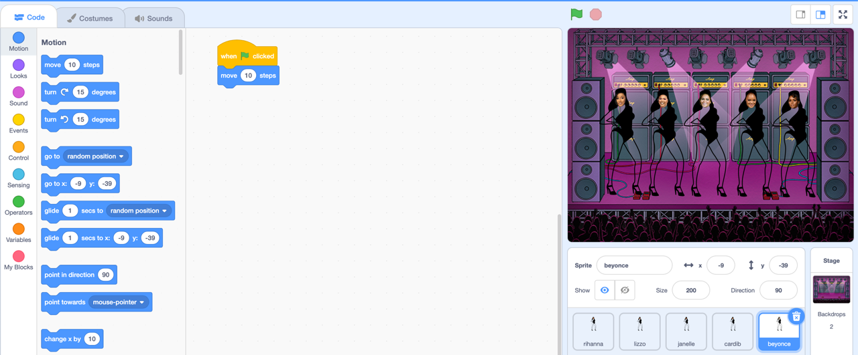
Move Our Characters with Code

Slide 14
Play!!!
Use other code blocks
Program different characters. Our girl, Lizzo, wants to move, too!
Change the Background

